Slide 1
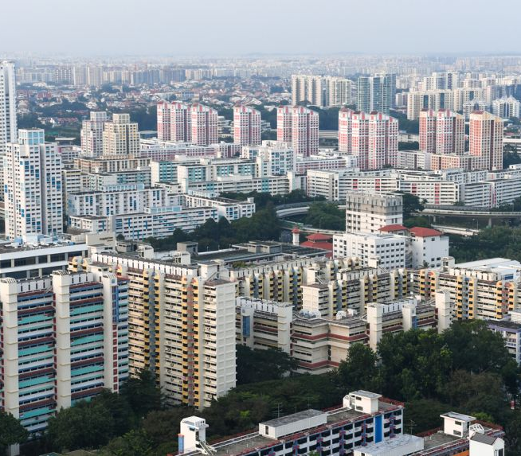
Predicting HDB Resale Price
Elang Setiawan
DSIF 2

Slide 2



Agenda
Project
Problem Statement
Result and conclusion
Lessons Learned
Geoprocessing
Mapping
ML Automation

Slide 3
Predicting HDB Resale Price
Property market is heating up
Location, location, location
Test the hypothesis with regression model
Cooling Measures

Slide 4
Predicting HDB Resale Price
HDB property information Contains information for all HDB including under development (12k)
HDB transacted prices from 1990 to yesterday Outlier prices are actual transacted prices Only data from 2017 is used for modelling (112k)
Geographical data from onemap.gov.sg
Query the API using address
Returned data: Latitude, Longitude, Postcode
Mapping

Slide 5
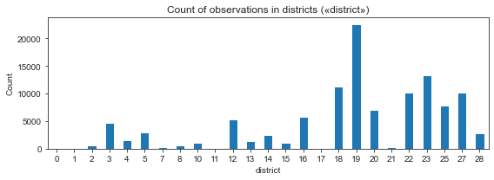
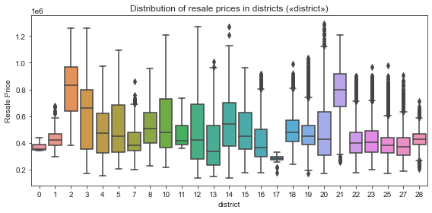

Slide 6
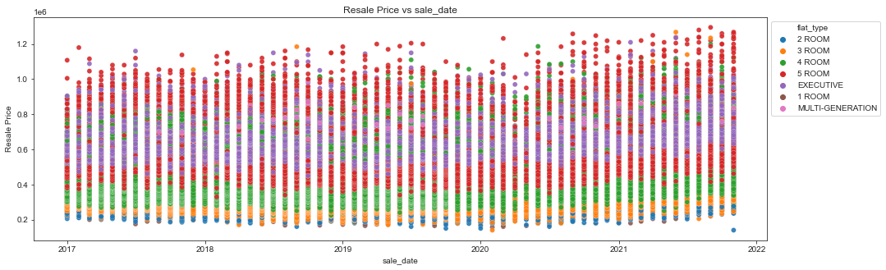

Slide 7
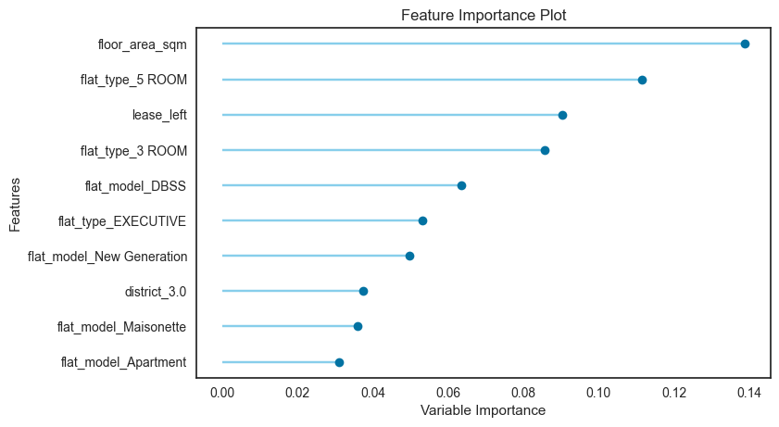
Features added: district code, number of MRT stations, primary school, and shopping centres within 1km.
Random Forest Regressor model is best with RMSE difference of 4.37%

Slide 8
In conclusion, the location features do not affect HDB price too much.
Size, type, and how many years to the end of lease are more important.

Slide 9
Geoprocessing
The earth is not flat
World Geodetic System 1984 (WGS 84) used by onemap.gov.sg
Calculate distance:
from pyproj import Geod
from shapely.geometry import Point, LineString
a = POINT (103.95337, 1.34319) # Simei MRT Station
b = POINT (103.98809, 1.38861) # 1 Changi Village Road
geod = Geod(ellps="WGS84")
distance = geod.geometry_length(LineString([a, b]))/1000 # km
Singapore is located at latitude 1.28967 and longitude 103.85007

Slide 10
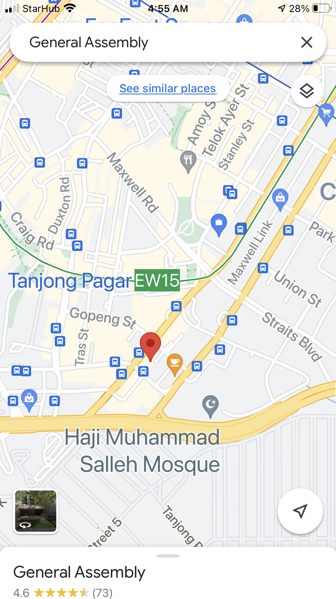
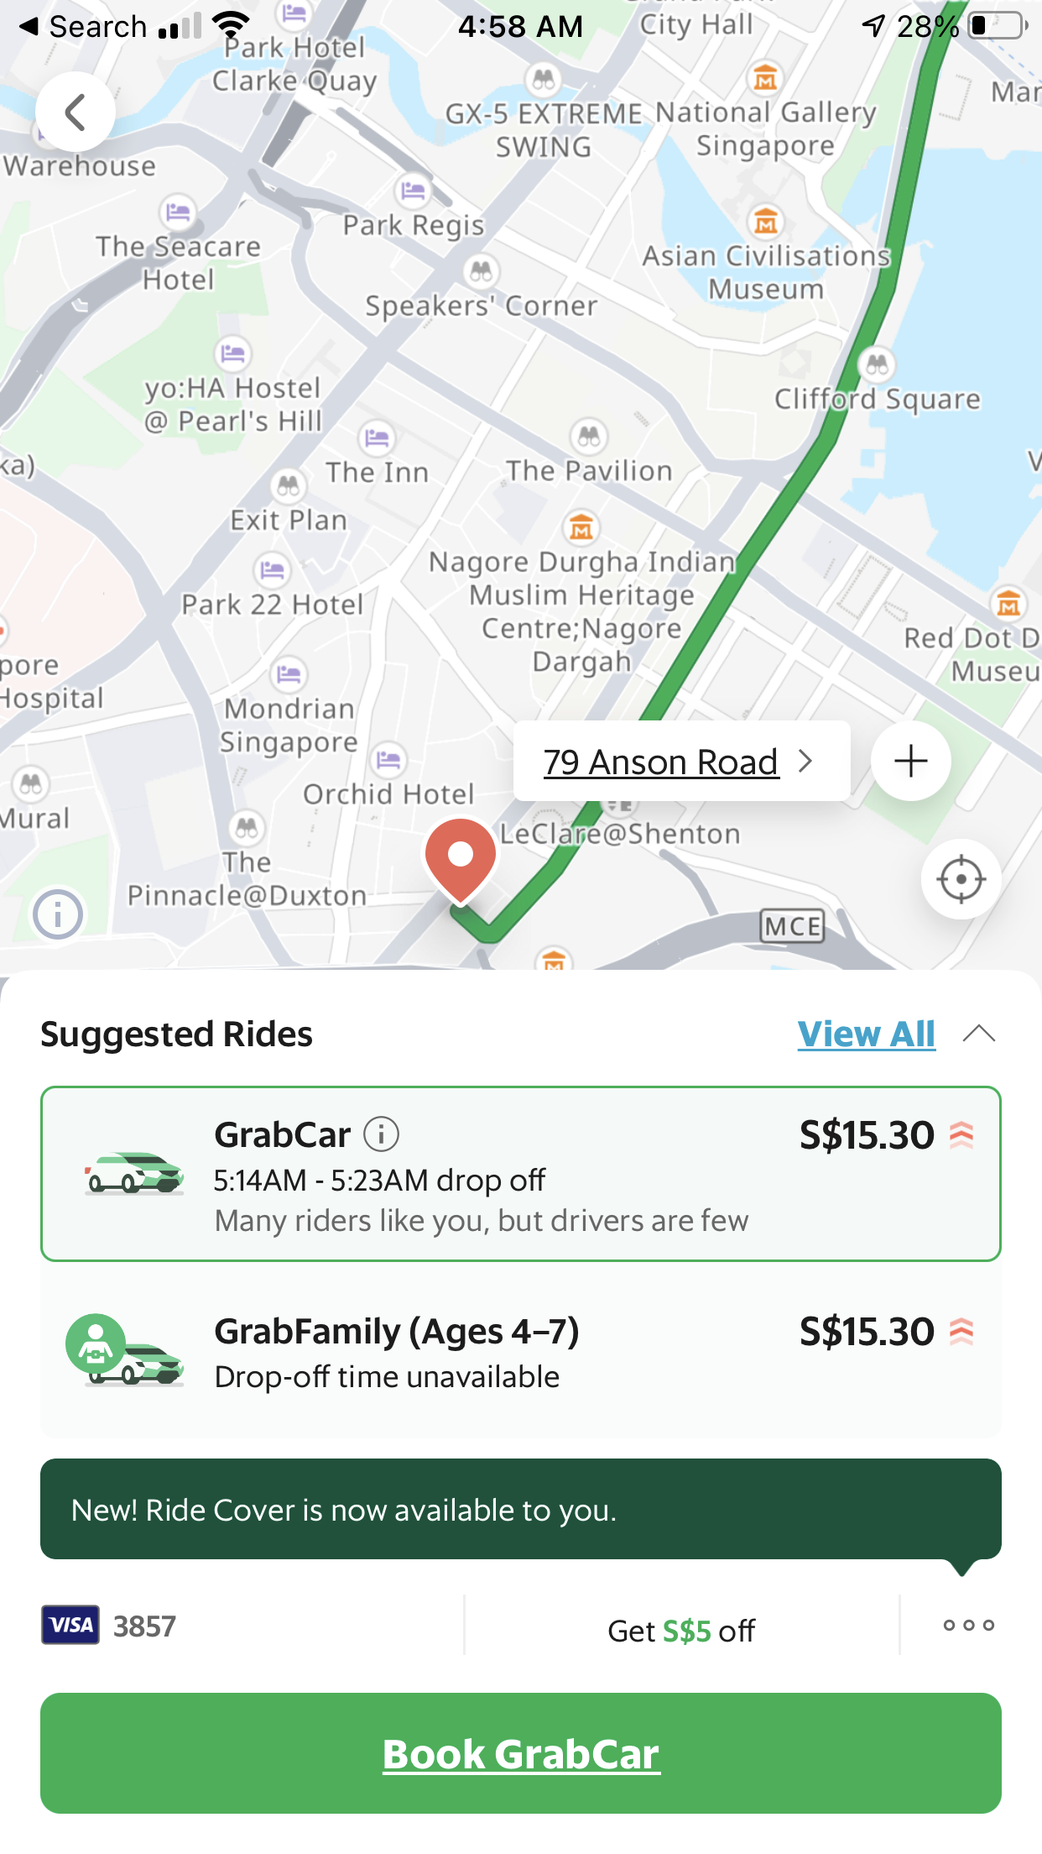
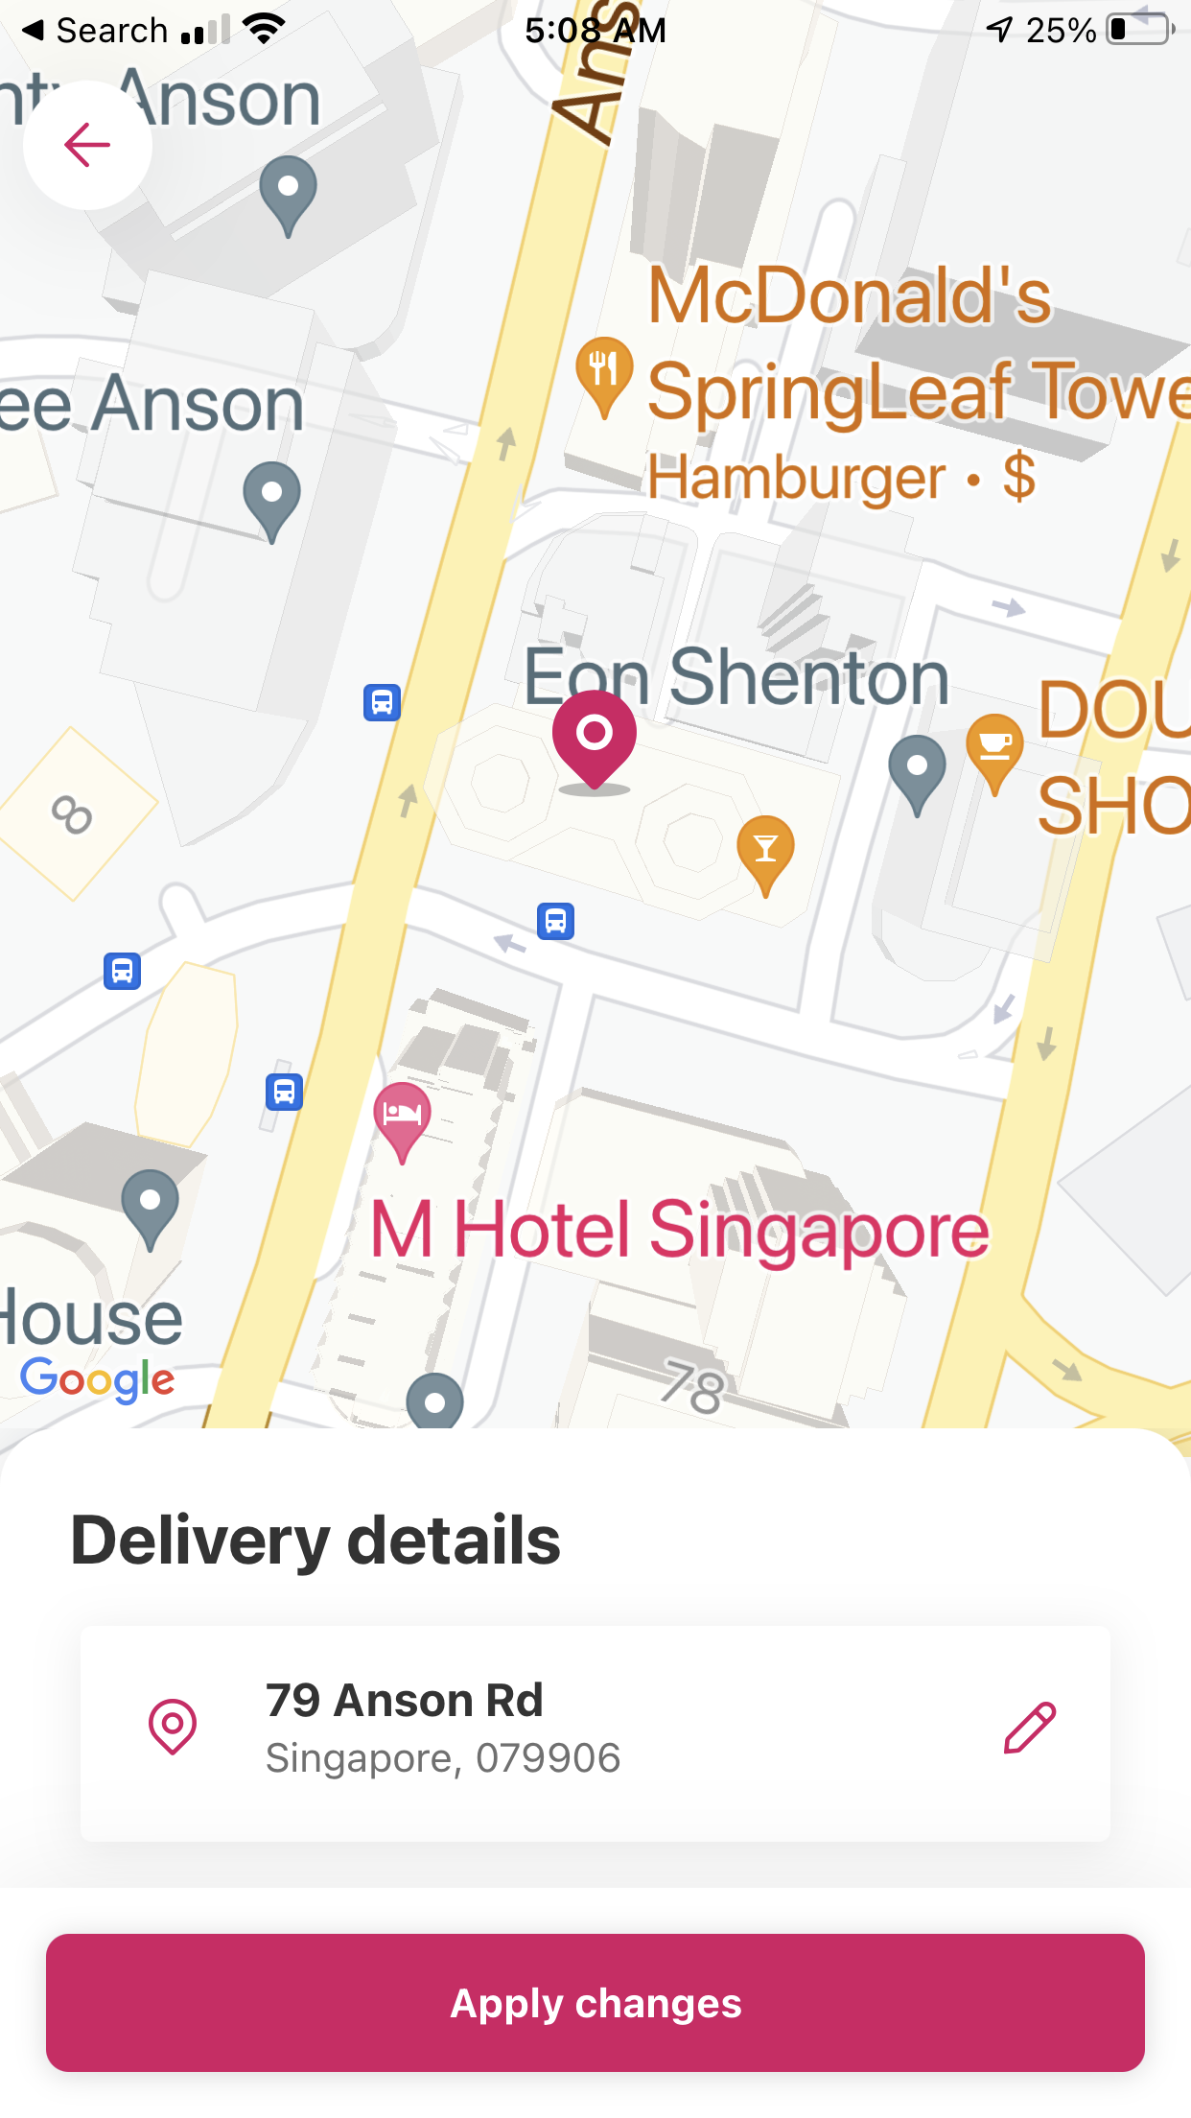
Mapping

Slide 11
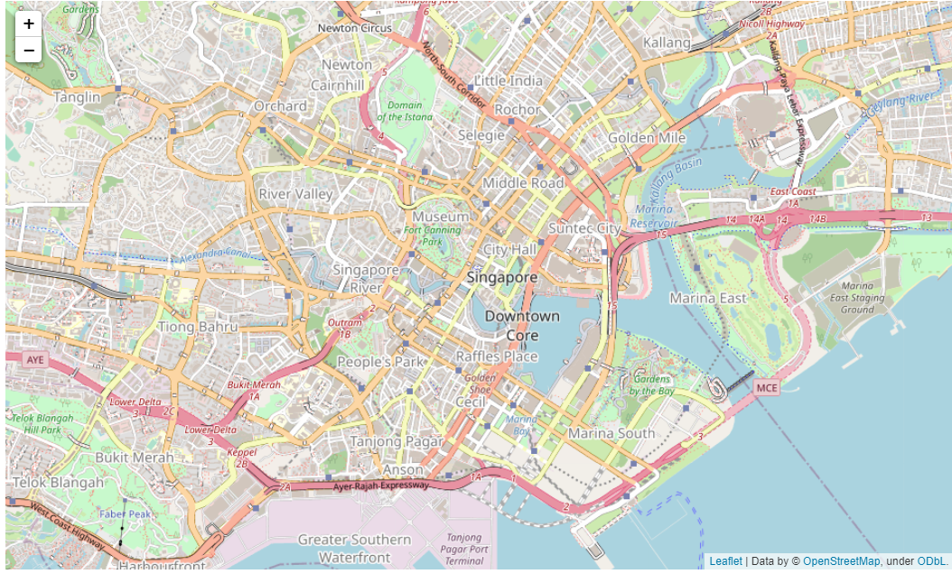
Mapping with Folium
import folium
map = folium.Map(location=[1.28967, 103.85007], zoom_start=14)
map

Slide 12
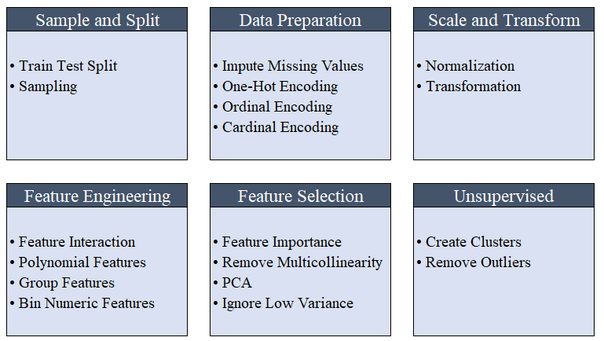
ML Automation with pycaret

Slide 13
ML Automation with pycaret
Modules
Classification
Regression
Clustering
Anomaly Detection
Natural Language Processing
Association Rule Mining

Slide 14
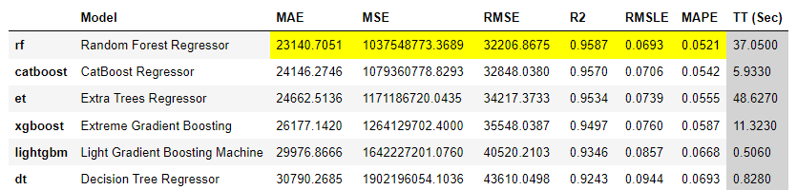
Automation with pycaret
from pycaret.regression import *
data = df_price.sample(frac=0.9, random_state=random_seed)
data_unseen = df_price.drop(data.index)
setup(data = data, target = 'resale_price', session_id=42)
best = compare_models(exclude = ['ransac'])

Slide 15
Automation with pycaret
rf_reg101 = create_model('rf')
rf_params = {'bootstrap’:[True,False],
'max_depth’:[5,6,7],
'max_features':['log2'],
'max_leaf_nodes':[None],
'min_impurity_decrease’:[0.0, 0.0001],
'min_samples_leaf’:[5],
'min_samples_split':[7],
'n_estimators':[100]
}
tuned_rf_reg101 = tune_model(rf_reg101, optimize='RMSE', custom_grid = rf_params)
predict_model(tuned_rf_reg101)

Slide 16




Summary
The hypothesis that location and other geodata is a strong price predictor is not true.
Use automation to reduce effort.
https://python-visualization.github.io/folium/
https://pycaret.org/

